Slide 1
What is client server technology…?

Slide 2
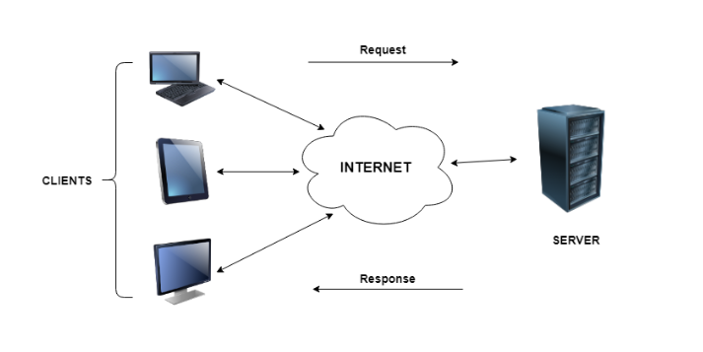
In client server computing, the clients requests a resource and the server provides that resource.
A server may serve multiple clients at the same time while a client is in contact with only one server

Slide 3
Characteristics of Client Server Computing
The client server computing works with a system of request and response.
A server can only accommodate a limited number of client requests at a time.
An example of a client server computing system is a web server. It returns the web pages to the clients that requested them.

Slide 4
Difference between Client Server Computing and Peer to Peer Computing
In client server computing, a server is a central node that services many client nodes.
On the other hand, in a peer to peer system, the nodes collectively use their resources and communicate with each other.
In peer to peer to computing, all the nodes are equal and share data with each other directly.

Slide 5
Advantages of Client Server Technology
All the required data is concentrated in a single place i.e. the server. So it is easy to protect the data and provide authorisation and authentication.
It is easy to replace, upgrade or relocate the nodes in the client server model because all the nodes are independent and request data only from the server.
Disadvantages of Client Server Technology
If all the clients simultaneously request data from the server, it may get overloaded. This may lead to congestion in the network.
The cost of setting and maintaining a client server model are quite high.

